Slide 1

Community Health and Violence Prevention Services (CHVPS) Evaluation for Harris County Public Health Services
Clarification of AIR’s and DIR’s Approach to this Work
Trenita Childers (AIR) | Sylvia Epps (DIR) | Maura Shramko (AIR) | Jasmine Olivier-McGregor (AIR) | Matthew Sweeney (AIR) | Candace Hester (AIR) | Maya Escueta (AIR)
August 28, 2024
Notes:
Welcome, everyone! My name is Maura Shramko and I’m a researcher at AIR, and I’ll be starting us off today.

Slide 2




Presentation Goals
Team Structure
Research Methods
Project Timeline and Commitments
Questions?
Notes:
Our goal for today is to walk through the our project team structure, and describe the research methods for each part of this evaluation, as well as the project timeline. We will also introduce our project team as we go. At the end we will leave time for questions and discussion.

Slide 3





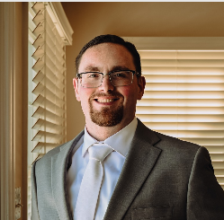

Team Structure
Co-Principal Investigator
Co-Principal Investigator
Sylvia Epps, PhD
Trenita Childers, PhD
Project Management
Quality Assurance
Maura Shramko, PhD
Candace Hester, PhD
Implementation Evaluation
Impact Evaluation
Cost Evaluation
Jasmine Olivier-McGregor, PhD
Matthew Sweeney, PhD
Maya Escueta, PhD
3
Notes:
I’m excited to present our team. We’ll start with our project team leaders, co-principal investigators, Dr. Trenita Childers and Dr. Sylvia Epps. Both can provide a brief intro to their work and expertise, and how that sets us up for this project.

Slide 4

Dr. Trenita Childers
AIR Senior Researcher
Training: Sociologist and Ethnographer
Research Interests/Expertise:
Public Health with a focus on Health Equity
Community-engaged and participatory design expert
Relevant Experience:
Co-Principal Investigator (co-PI) of Indy Peace Fellowship Credible Messenger Mentoring Evaluation with the National Institute for Criminal Justice Reform (NICJR)
Project Director of the Health Equity for Afghan Refugees (HEAR) Project

Slide 5

Dr. Sylvia Epps
DIR President
Training: Developmental Psychologist
Research Interests/Expertise:
Youth development
Early childhood and adverse conditions
Relevant Experience:
Project Director of Harris County Community COVID Housing Program and Re-Entry
Project Director of National Evaluation of the American Rescue Plan
Project Director of George Kaiser Family Foundation’s Birth through Eight Strategy

Slide 6
Evaluation Overview
Formative Evaluation of Program Implementation
Purpose: To understand HART and RISE program components and implementation
Summative Evaluation of Program Impact
Purpose: To assess changes in gun violence and arrests associated with HART and RISE programming
Cost Evaluation
Purpose: To understand HART alternative first responder program and RISE gun violence interrupters program costs and cost to outcomes
Notes:
Next we will walk you through our proposed evaluation approaches to understand the Community Health Violence Prevention Services, and specifically the programs, HART alternative first responders, and RISE gun violence interrupters.
First, we’ll describe the formative evaluation of program implementation
which aims to understand HART and RISE program components and implementation, respectively.
Second, we’ll present the summative evaluation of program impact to examine changes in gun violence and arrests associated with HART and RISE programming
Finally, we will describe the cost evaluation, which will assess the costs of the HART alternative first responder program, and the RISE gun violence interrupters programs, respectively, and the costs to outcomes.

Slide 7
Formative Evaluation of Program Implementation
Notes:
I will hand off now Dr. Jasmine Olivier-McGregor, who will share more about the formative evaluation of program implementation. (Keep at 5 minutes)

Slide 8

Dr. Jasmine Olivier-McGregor
AIR Researcher
Training: Sociology
Research Interests/Expertise:
Community-Based Public Safety Alternatives
Qualitative methods and Community Participatory Approaches
Relevant Experience:
Implementation evaluation lead for community violence intervention project
Coalition to Advance Public Safety Initiative
Indy Peace Fellowship Credible Messenger Mentoring Evaluation
Evaluation Lead for city-wide public safety and justice project:
Neighborhood Opportunity and Accountability Board
Evaluation Lead for Multi-Site Alternative First Response Collective
Notes:
Thanks, Dr. Shramko. My name is Jasmine Olivier-McGregor and I am researcher at AIR. I am sociologist by training with a background in justice reform research with a focus on community-based public safety alternatives.
I’m skilled in qualitative methods such as interviewing, focus groups, and ethnography as well as community participatory research.
At AIR, I lead implementation and formative evaluations of multi-site and city-wide programs related to community violence intervention (or CVI), public safety and justice, and alternative first response. I lead the implementation evaluation of the Coalition to Advance Public Safety (CAPS) Initiative, which is a multi-site effort led by four national CVI TTA providers, including the National Institute for Criminal Justice Reform, working together to reduce gun violence in cities throughout the US, including cities in the south.
I also serve as the implementation lead for an evaluation of the Neighborhood Opportunity and Accountability Board, which is a youth restorative justice diversion program located in Oakland, California. And as the Community Advisory Board Lead for the Indy Peace Fellowship Credible Messenger Mentoring Evaluation, I employ a community-participatory research design to ensure that our project upholds equitable evaluation principles.
I also lead the formative evaluation of a multi-site collective of alternative response programs led by the Center for Innovation in Community Safety (CICS) at Georgetown Law.
Overall, I am excited about the opportunity to apply the knowledge base and skillsets from our ongoing CVI, public safety and justice, and alternative response evaluation partnerships to the formative evaluation of the HART and RISE programs.

Slide 9

Formative Evaluation Research Questions
Research Questions | Sample
1a. What are the HART and RISE program core components? 1b. How are the HART and RISE core components implemented? 1c. What are implementation facilitators and barriers? 1d. What are client perceptions of the HART and RISE programs? What are perceived program benefits? | HART and RISE: Key informants (program leads) Program staff Program participants or clients Existing HART and RISE program data
Notes:
Our formative evaluation seeks to answer four primary research questions, which include
A- What are the core components of the HART and RISE programs?
B- How are the HART and RISE core components implemented (including intervention timing, intervention dose, mentor/mentee/staff characteristics, and community resources).
C- What are the implementation facilitators and barriers
D- What are client perceptions of the HART and RISE programs, including perceived programs benefits.
To answer these RQ's, we will collect interview and survey data from a sample of HART and RISE program leads, program staff, and program clients or participants.
We will also analyze existing HART and RISE program data.

Slide 10



Formative Evaluation of Program Design
The aims of the formative evaluation are as follows:
Better understand the RISE and HART core components.
Identify core characteristics of RISE and HART implementation.
Examine key barriers and facilitators of implementation of RISE and HART.
Assess participants’/clients’ perceptions of the HART and RISE programs.
GOAL
Interviews
30 staff and 30 program participants
Online Surveys
Short staff surveys at key program milestones
Program Data
Analysis of administrative records
Notes:
Ultimately, we seek to:
-deepen our understanding of program core components,
-the core characteristics of program implementation,
-the key program facilitators and barriers, and
-client program perceptions.
To achieve these goals, we will conduct interviews with 30 staff and 30 program participants, administer short surveys to program staff at key program milestones, and analyze program data, including administrative records.

Slide 11
Summative Evaluation of Program Impacts
Notes:
Next, I will turn it over to Dr. Matthew Sweeney and Dr. Candace Hester to describe the summative evaluation of program impacts.

Slide 12
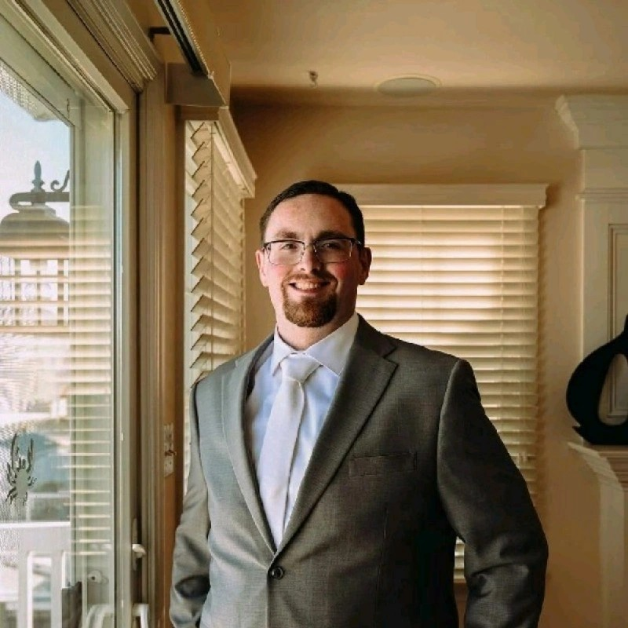
Dr. Matthew Sweeney
AIR Senior Researcher
Training: Criminology and Public Policy
Research Interests/Expertise:
Administrative Data Systems
Law Enforcement Policy and Practice
Relevant Experience:
Justice and safety research with Harris county administrative data:
Justice Policy Research Analyst at Harris County
Project Director of evaluation of Harris County COVID Community Housing Program
Project Director of Harris County Women’s Empowerment Center evaluation project
National law enforcement evaluation and technical assistance project work:
Evaluation lead for the Institute for American Police Reform project
Administrative data security/privacy lead for the Benchmark Analytics project
Notes:
Keep at 5 minutes for Matt’s section

Slide 13
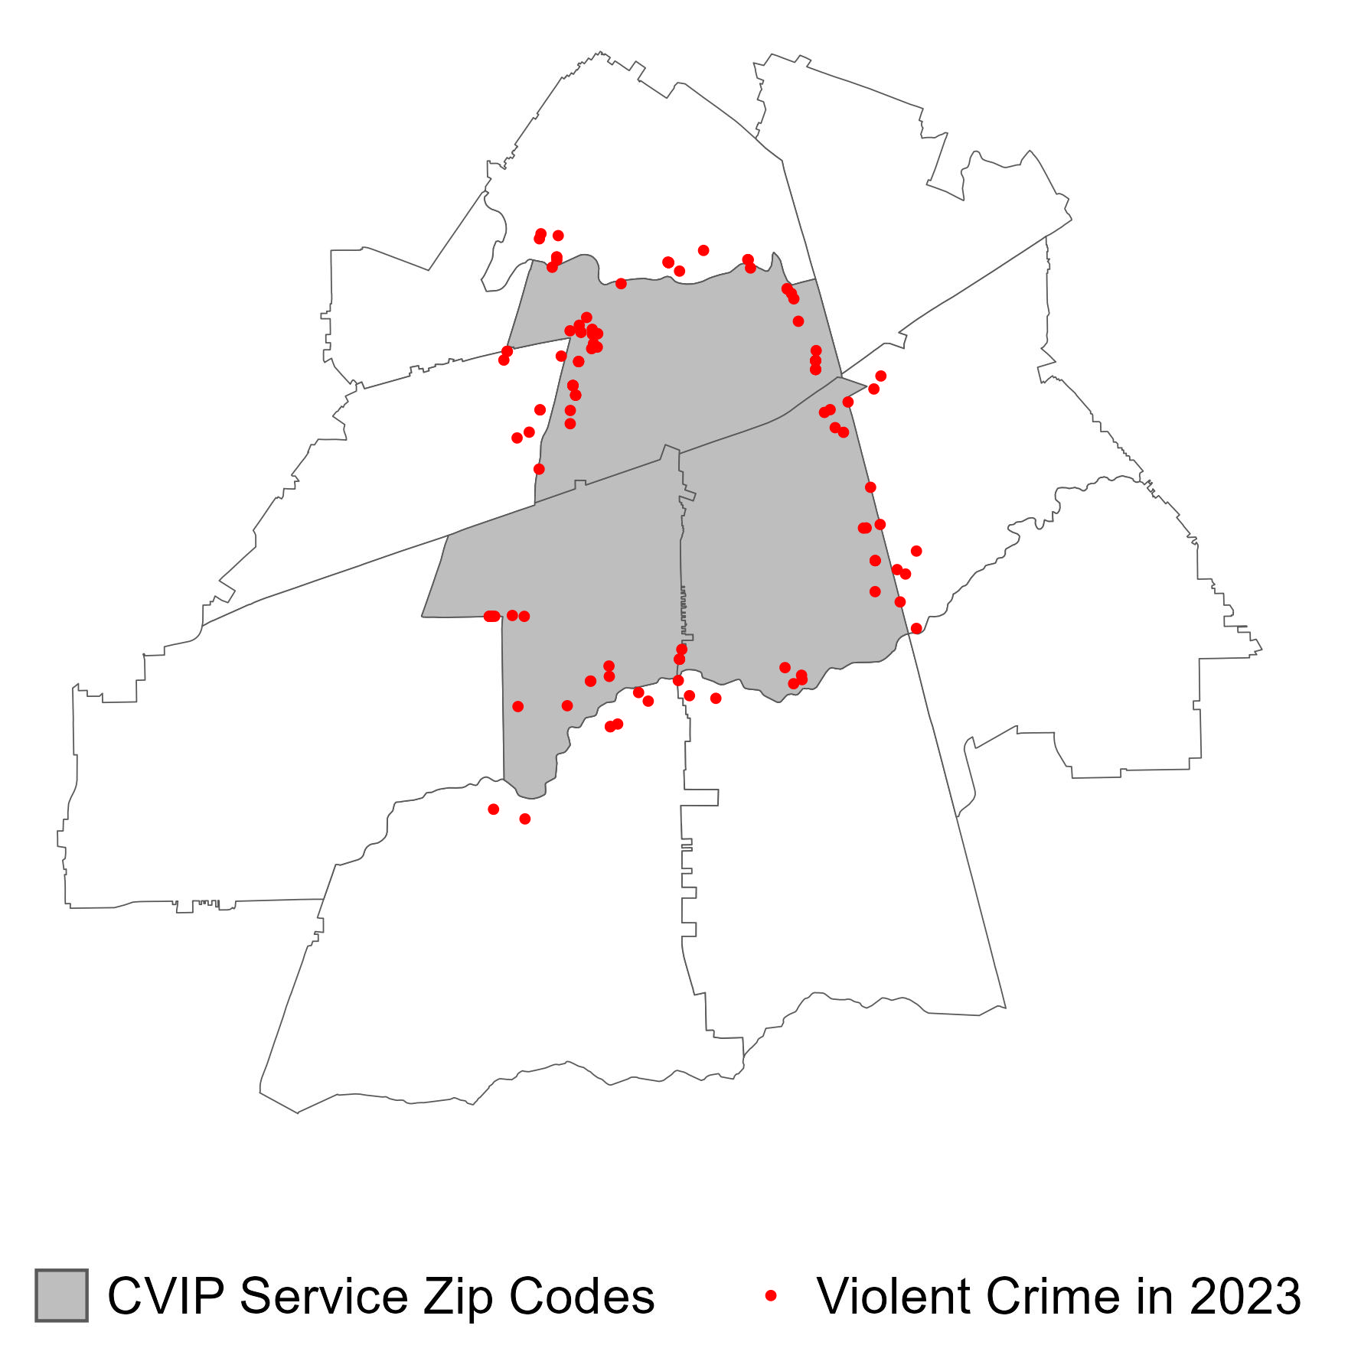
Summative Evaluation Research Questions
Research Questions | Sample
2a. To what extent does RISE reduce overall rates of homicides, shootings, and/or other community violence incidents? 2b. To what extent does HART result in reduced overall crime and arrest rates for alternative first response-eligible offenses? | Communities receiving RISE services: For CVIP: three zip codes in Sunnyside, one in Cypress Station For HVIP: HCA Houston Healthcare Northwest and Ben Taub Hospital Communities receiving HART services Police Districts 1 and 4
Notes:
RQs across Rise and HART look to compare the impact of these programs within locations that receive services and those that don’t
- Each program will look at specific metrics related to RISE and HART including shootings, homicides, violent crime, arrest rates, and alternative response rates.

Slide 14
Summative Evaluation Data Sources
Data | Variables | Source | Strategy
Calls for Service/ Criminal Incidents | Shots Fired, Non-Fatal Shootings, Homicides/Fatal Shootings, Gang Incidents | Harris County Sheriff’s Office (Assistant Chief Thomas Diaz and Mr. David Klozik) Potentially: Constable Precincts for Additional Call Logs/Service Logs) | Departmental Consultation With HCSO (Identify Data Elements) Commissioners Court Data Release (Expedite Data Release)
 | Calls for Service That Underwent HART Eligibility Screens
Harris County Detention Facility and Joint Processing Center Data | Inmate Intake and Release Information, Mental Health/Homelessness/Substance Use Flags | Harris County Sheriff’s Office (Assistant Chief Phillip Bosquez, Major Patrick Dougherty, and Dr. Thomas D. McNeese)
Regional Demographics | Zip-Code Level Demographics | American Community Survey | Direct Download From United States Census Bureau
HART and RISE Internal Data | Number of Responses, Outcomes of Responses, Internal Documentation Regarding Policies and Procedures | Harris County Department of Public Health (Lupe M. Washington) | Departmental Consultation With HCPH (Identify Data Elements) Commissioners Court Data Release (Expedite Data Release)
Notes:
While most Harris County data are within Universal Services systems, we will need to work with individual departments to identify and request the specific data elements that are related to RISE and HART.
Anticipate working with HCSO and DPH but may need to consult Constable Precincts that overlap with HART and RISE districts for additional calls for service information as some residents will directly call their Constable instead of the HCSO or 911.
One of our current projects with Harris County required us to collect data on persons reentering society from the Harris County jail. Within the fist couple of months, we had agreed on the specific data elements with the County Administrator’s Office. Still, over one year later, there was no movement as the request stalled within the Data Governance Committee. A recent solution was to proposed the data release as a Commissioners Court agenda item to expedite the process. This circumvents the need to go through administrative hurdles, and thus, to maintain the tight timeline for this project, we anticipate this being the most expedient method to access and retrieve the data.

Slide 15
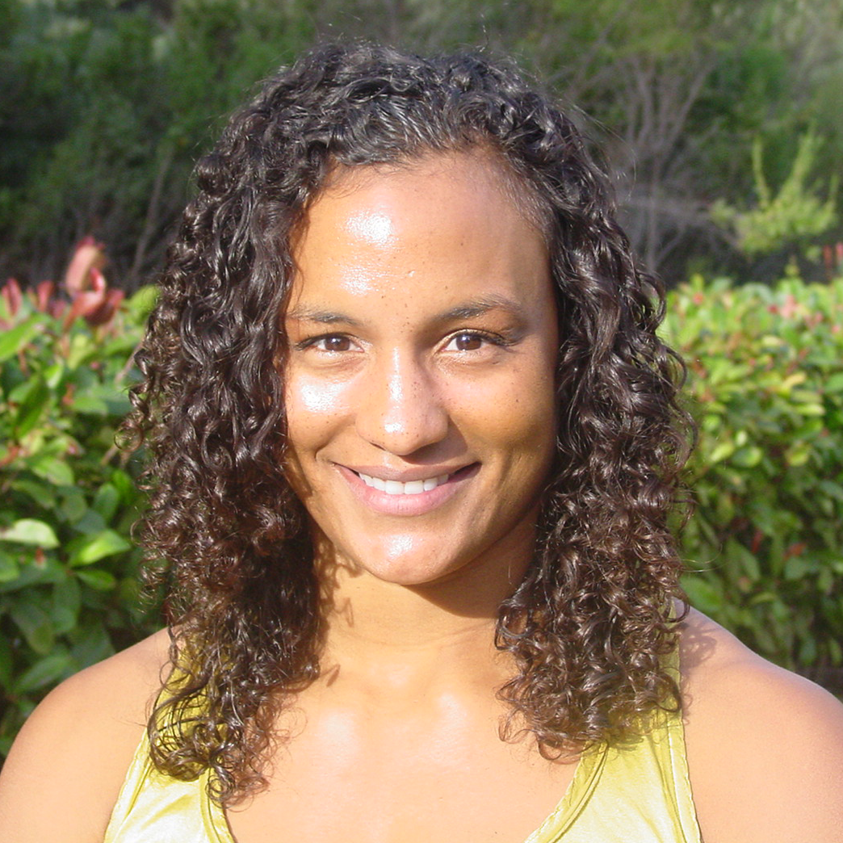
Dr. Candace Hester
AIR Principal Researcher & Advancing Justice Portfolio Lead
Training: Public Policy and Economics
Research Interests/Expertise:
Complex, rigorous, and community engaged research design
Community-led and community-based reforms
Policing, justice, and school systems redesign
Relevant Experience:
PI for community violence intervention evaluation projects:
Coalition to Advance Public Safety Initiative
Indy Peace Fellowship Credible Messenger Mentoring
PI for city-wide justice and public safety evaluation projects:
San Francisco Department of Children Youth and their Families [DCYF] Justice Services Programming
Neighborhood Opportunity and Accountability Board
PI for Multi-Site Alternative First Response Collective
Center for Innovations in Community Safety at Georgetown Law
Notes:
5 minutes for Candace

Slide 16

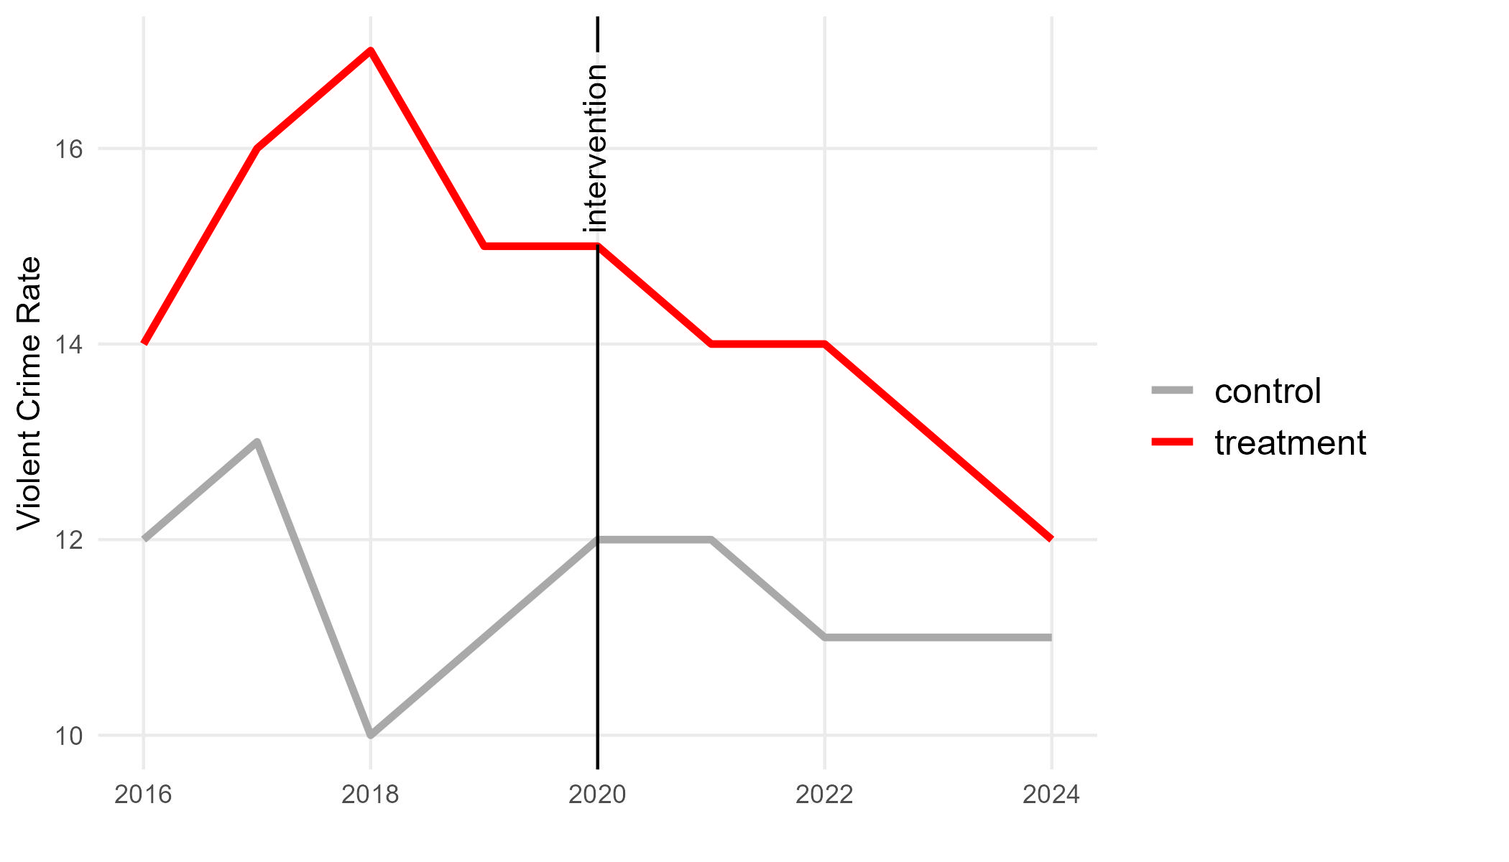
RISE Summative Evaluation Design
Difference-in-differences impact designs with synthetic controls are the strongest quasi-experimental method for estimating CVI program impacts (Braga et al., 2013).
Difference-in-differences designs enable AIR to estimate relative changes between served and nonserved zip codes, before and after RISE implementation.
Note: CVI = Community Violence Intervention
Notes:
Community level: how are outcomes different in service areas compared to non-service areas and is this attributable to RISE programing?
Synthetic control DID: accounts for differences before and after program implementation, while also accounting for pre-existing differences between service and non-service areas, which could bias results if left unaddressed

Slide 17
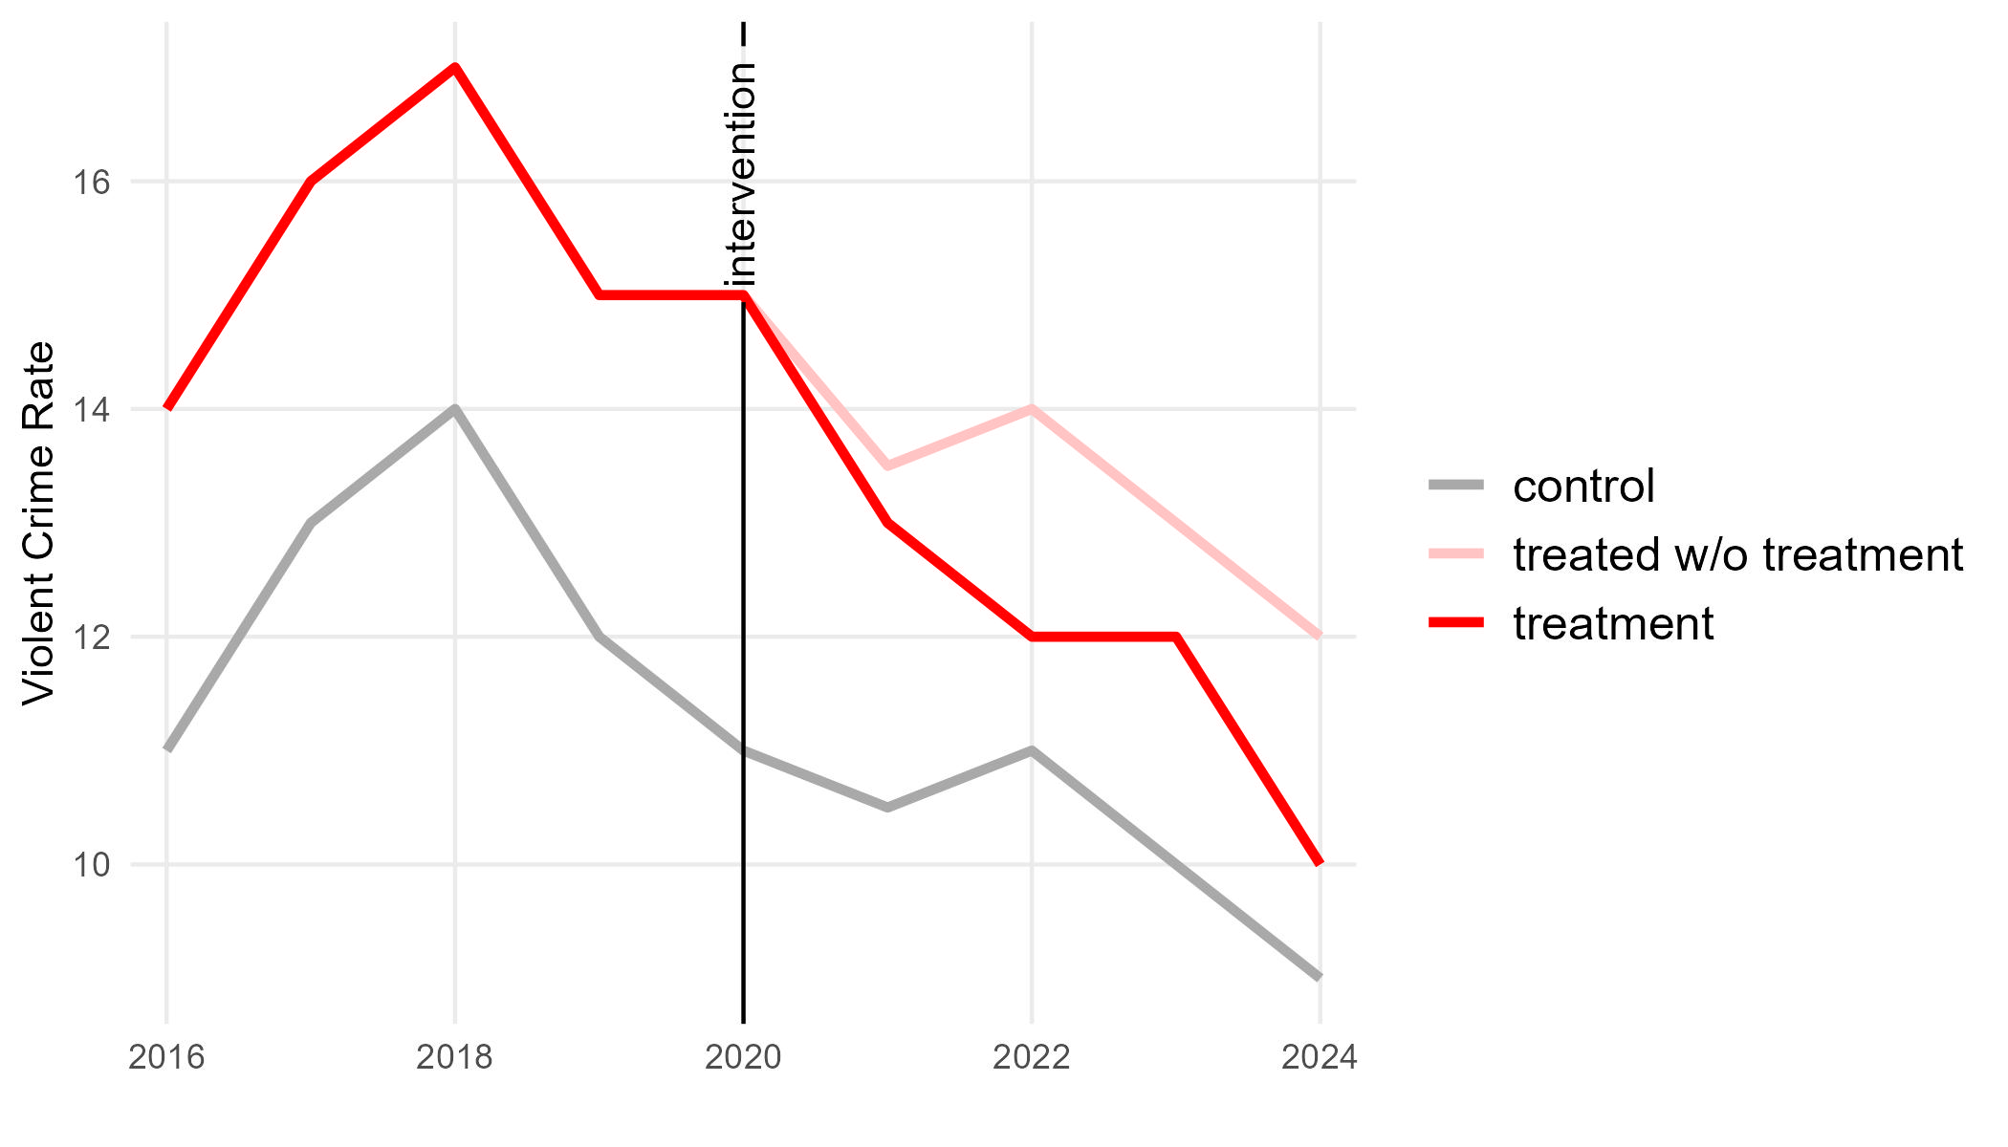
RISE Summative Evaluation Design
Difference-in-differences impact designs with synthetic controls are the strongest quasi-experimental method for estimating CVI program impacts (Braga et al., 2013).
Difference-in-differences designs enable AIR to estimate relative changes between served and nonserved zip codes, before and after RISE implementation.
Synthetic controls build the strongest statistical comparison to account for pre-intervention differences between served and nonserved zip codes, decreasing the potential for bias.
treatment effect
Note: CVI = Community Violence Intervention
Notes:
Community level: how are outcomes different in service areas compared to non-service areas and is this attributable to RISE programing?
Synthetic control DID: accounts for differences before and after program implementation, while also accounting for pre-existing differences between service and non-service areas, which could bias results if left unaddressed

Slide 18

HART Summative Evaluation Design
Difference-in-differences impact designs are the strongest quasi-experimental method for estimating AFR program impacts (Dee & Pyne 2022).
Difference-in-differences designs allow AIR to estimate the impact of HART in served police districts compared with statistically similar nonserved police districts.
AIR can also leverage the variation in the timing of HART service availability to introduce a third difference or other designs (e.g., regression discontinuity).
7 am | 8 am | 9 am | 10 am | 11 am | 12 pm | 1 pm | 2 pm | 3 pm | 4 pm | 5 pm | 6 pm | 7 pm | 8 pm | 9 pm | 10 pm | 11 pm | 12am | 1 am | 2 am | 3 am | 4 am | 5 am | 6 am
911 Calls
HART Service Hours
HART Off Hours
Note: AFR = alternative first response
18

Slide 19
Cost Evaluation
Notes:
Finally, Dr. Maya Escueta will present the proposed cost evaluation methods– 5 minutes

Slide 20
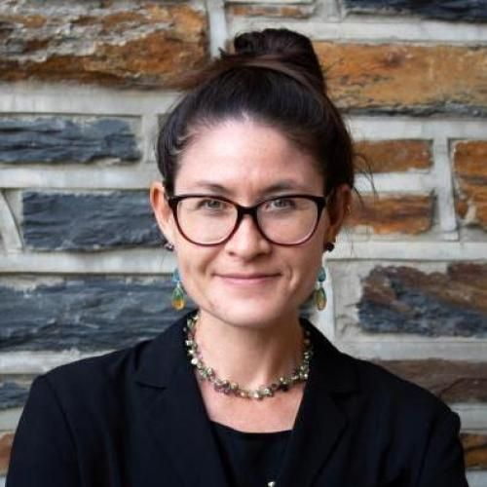
Dr. Maya Escueta
AIR Researcher
Training: Economics and Public Policy
Research Interests/Expertise
Cost and impact evaluations of social interventions that serve marginalized populations
Household violence and early trauma
Capacity building for evidence use and decision-making
Relevant Experience:
Cost model lead on state-level projects to estimate costs of childcare and several school-based interventions
Quasi-experimental and experimental work examining intergenerational effects of community and household-level violence
Notes:
5 minutes for cost evaluation

Slide 21



Cost Evaluation
3a. What are the overall costs associated with implementing each CHVPS program, and the associated per-participant costs?
3b. How are costs spread across program components and/or ingredient categories (e.g., Personnel, Materials/ Equipment, Training)?
3c. How do costs vary by service area and location, and how are these variations related to the populations served in these areas?

Slide 22




Cost Evaluation Data Sources
To understand the costs associated with the community-level impacts, we will estimate the community-level and per-participant cost of implementing each of the CHVPS programs relative to a business-as-usual condition.
Conduct key informant interviews with program leads.
Request extant salary databases if available.
Conduct implementation interviews and surveys with program staff.
Leverage available program data.
Notes:
Sarah – paste slide

Slide 23
Cost Evaluation Analysis
STEP 1
STEP 2
STEP 3
STEP 4
Identify all resources or “ingredients.”
Specify the quantity of each ingredient.
Value each ingredient according to their market prices or equivalents.
Estimate the economic costs of each ingredient by multiplying.
Collect both quantitative and qualitative characteristics through existing documents, interviews, observation, and administrative data.
Administrative data and interviews or surveys
Develop price database using national or local prices.
Methodology from Levin, McEwan, Belfield, Bowden, and Shand (2018)
23
Notes:
(Levin, McEwan, Belfield, Bowden, & Shand, 2018)
Lack of available or complete data on implementation often requires intensive interviewing and data collection to recover quantities and characteristics of ingredients and induces a small sample problem that limits inference, and relies on strong assumptions
Calculate costs based on a Resource Cost Model
Organizing the data collection around the specific activities related to the provision of a service, strategy, or intervention
Based on the “ingredients” approach to cost analysis (Belfield et al, 2018), and it models the structure and ingredients of services that are provided under each intervention.
For each identified resource (personnel and non-personnel), information about its quantity (e.g. number of hours, size of training room) and quality (e.g. staff, facility specifications) is used to identify a market price.

Slide 24
Project Timeline and Commitments
Notes:
As I mentioned, I’m Maura Shramko, and will be walking through our plan for a feasible project timeline and our commitments at AIR and DIR. (5 minutes)

Slide 25

Dr. Maura Shramko
AIR Researcher
Training: Developmental Science, Public Policy
Research Interests/Expertise:
Health promotion and violence prevention
Participatory and mixed-methods research design
Relevant Experience:
Project Director of Indy Peace Fellowship Credible Messenger Mentoring Evaluation with NICJR
Implementation Evaluation Lead of Community Covid Housing Program Evaluation with Harris County
Research Lead for program evaluations with justice involved youth:
Youth Detained in San Francisco’s Juvenile Hall with DCYF
Implementation Evaluation of Jefferson Parish Diversion Program
Cross-system Coordination for Justice-Involved Youth in Milwaukee
Notes:
First I’ll quickly share a little about me. My training is in developmental science and public policy, and broadly my research focuses on health promotion and violence prevention for youth and communities with a public health lens.
At AIR, my work has focused on public health and justice spaces. I am project director for the evaluation of the Indianapolis credible messenger work mentioned earlier with Dr. Childers and Dr. Hester. I also serve as implementation or research lead on several program evaluations serving justice involved youth., including interviews to elevate the voices of young people detained in San Francisco’s juvenile hall. Finally, in Harris County, I’ve also been working with Dr. Epps and Dr. Sweeney on the Harris County evaluation of the Community COVID Housing Program.
I am excited to leverage my experiences leading this body of work as project director for this project.

Slide 26
Project Timeline – Key Phases
Data analysis
Qualitative data analysis
Impact analysis
Cost analysis
Project Planning
Logic Model
Evaluation Plan
November 2024–January 2025
May–July 2025
August–October 2024
February–April 2025
Data collection
Interviews
Surveys
Administrative data cleaning
Dissemination
Final reporting for each evaluation
Notes:
For our project timeline, this slide shows some of the key phases and outputs we anticipate, based on the original timeline.
We plan to focus on initial project planning in partnership with HC, including finalizing logic models and evaluation plans for RISE and HART in August through October.
Across the project, we plan to meet with Harris County Public Health to ensure opportunities for collaboration and feedback.
We will aim to begin data collection across evaluations by Fall, and data analysis will take place in the spring, to produce a report by next year summer.
However, we want to emphasize that we will work closely with Harris County Public Health to finalize the project timeline.
We are aware that often project timelines may be designed with a best-case scenario in mind to align with specific budget or funding cycles. AIR can work to generate results within necessary timeframes even when its an interim result to help support Harris County in meeting specific deadlines or budgetary guidelines.
In addition, our firm allows us to work in good faith prior to the execution of a contract. We know that sometimes agreements can take a while to receive signatures due to administrative schedules.
We have used these strategies in the past to ensure efficiencies, for example, when working with Harris County.
This will give us the flexibility and responsive to Harris County’s needs to get this project started through completion in a timely manner.

Slide 27
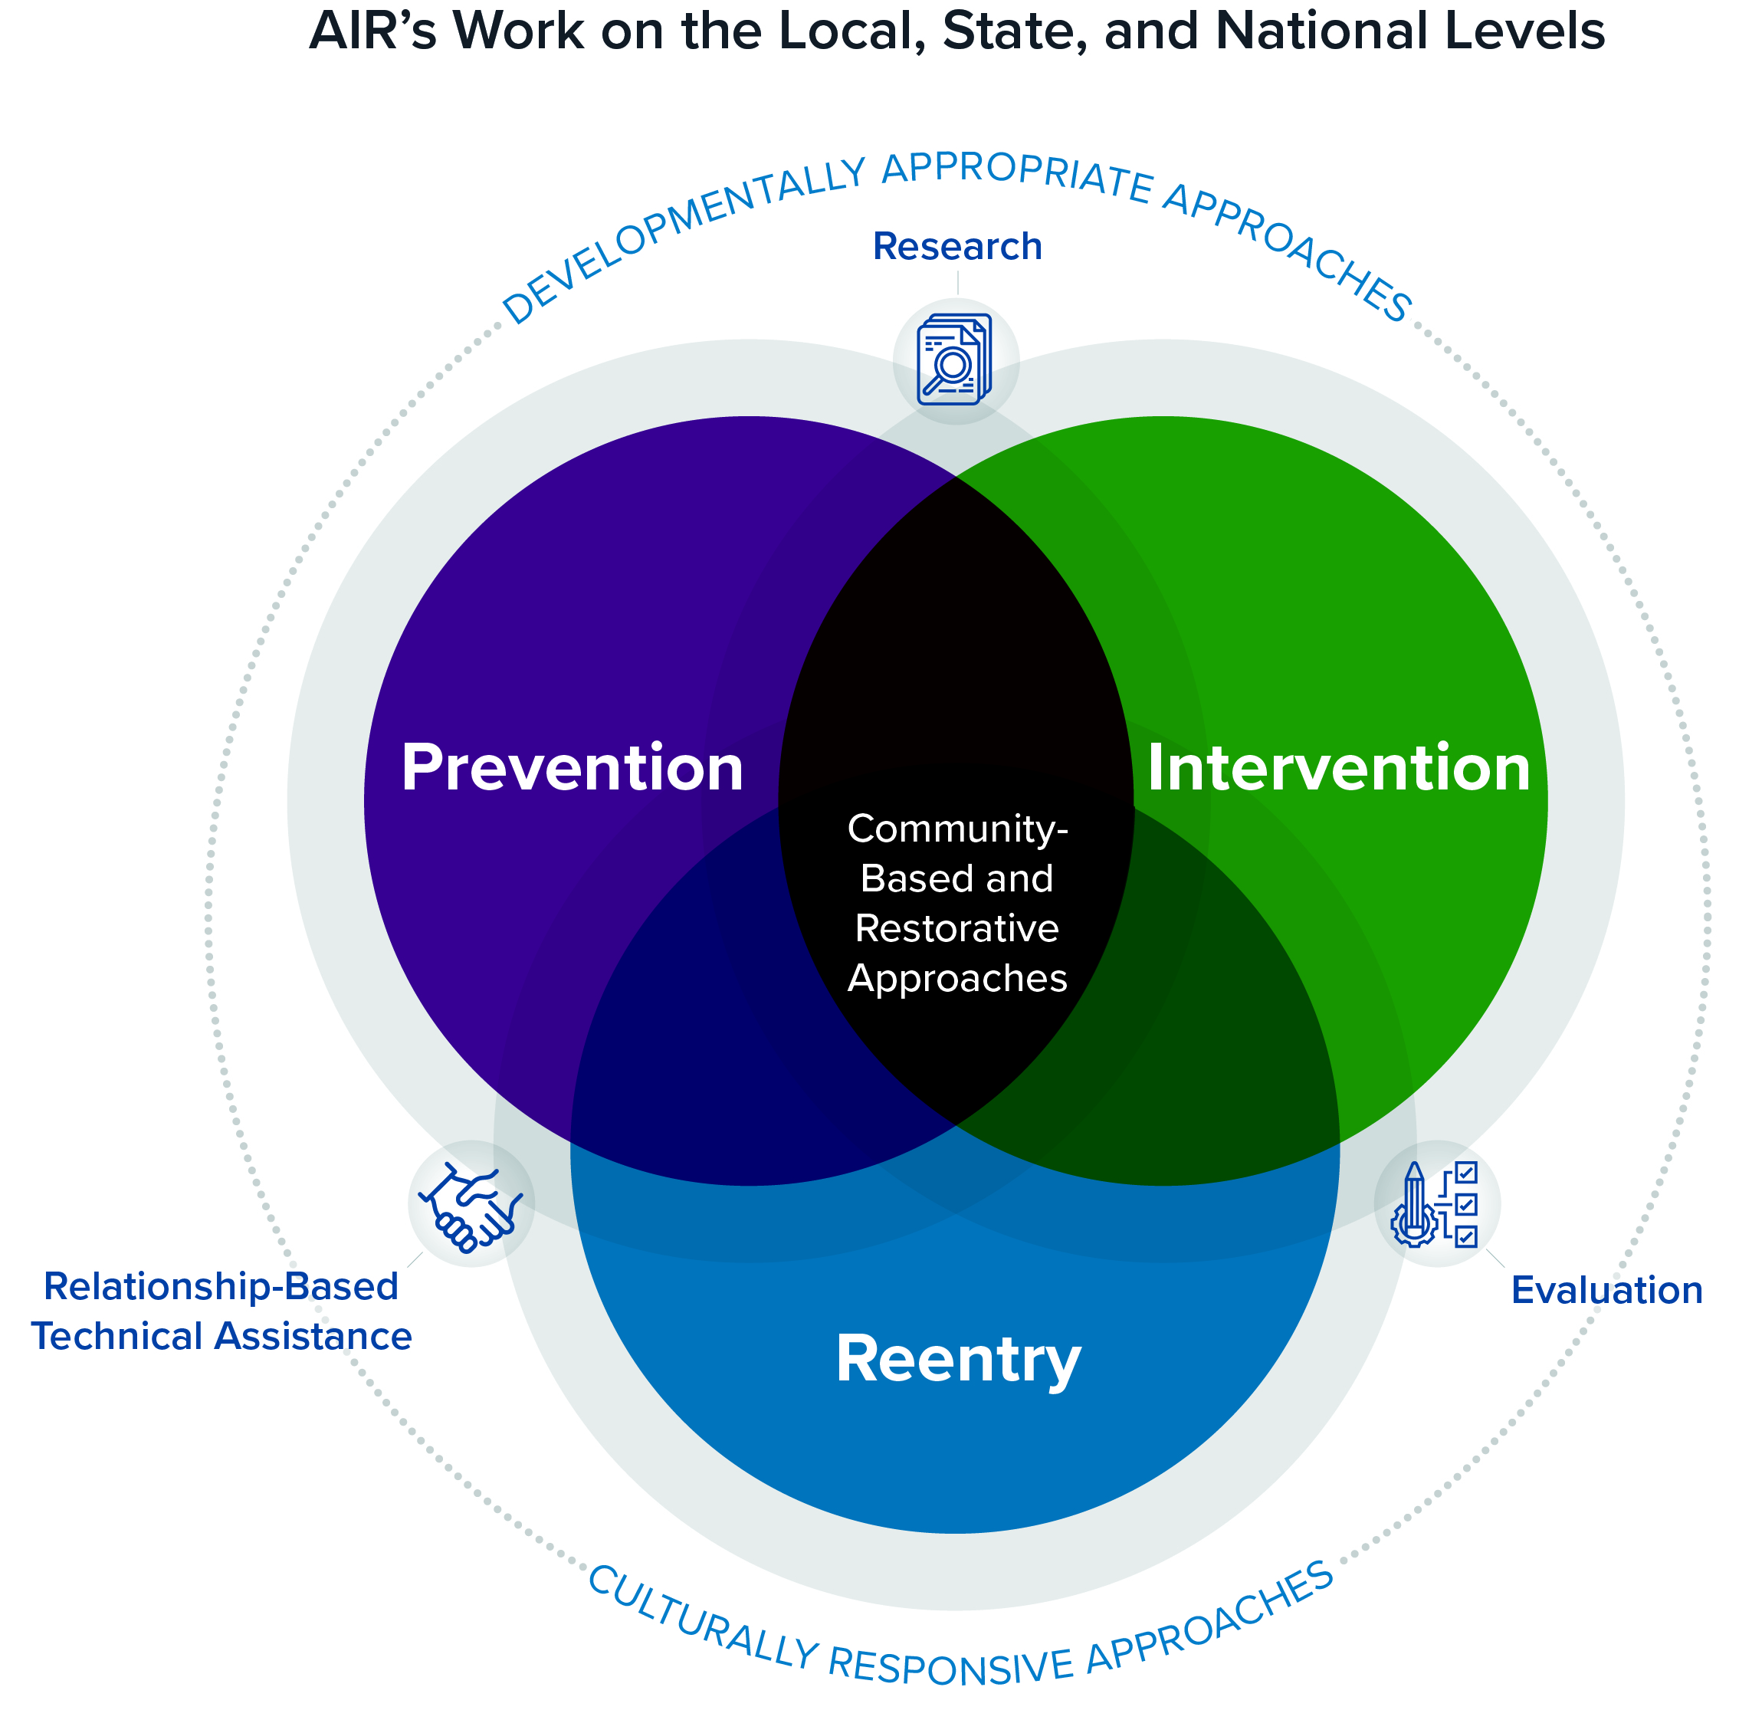
AIR and DIR bring a shared commitment to bridging rigorous research and culturally responsive practice to enable effective solutions
Notes:
Finally, we also bring a core commitment to bridging rigorous research and culturally responsive practices to enable effective solutions.
-This is exemplified by our past work engaging equitably with vulnerable populations, with communities of color, with those who are directly impacted by community violence.
-In addition, an example of this commitment is AIR’s Equity Initiative, which is a $105million dollar investment, and which highlights our commitment to the generation and use of evidence to address key structural challenges facing communities.
-Finally, AIR instituted culturally and linguistically appropriate standards for projects, research, and operations (or CLAS PRO) that guide all aspects of our work, from business to research to operations. For example, in recent projects, such as AIR and DIR’s evaluation of the Harris County Community COVID Housing program or CCHP, we collaborated with a local board of individuals with lived experience to guide our protocol development and recruitment. Such approaches actually improve the rigor of our evaluation methods, helping ensure better results for our clients.

Slide 28

Public health approaches to violence prevention and intervention embrace the social determinants of health.
Content source: National Center for Injury Prevention and Control, Division of Violence Prevention
Notes:
And to close, that means that we are really committed to a public health approach that embraces the social determinants of health towards violence prevention and intervention
This commitment to a public health approach also is reflected by the interdisciplinary team that we’ve brought together. This includes experts in public health, community violence intervention, key methods needed to understand these social issues such as quasi experimental design, in cost analysis, with strong representation to Texas and Harris County to understand the local context
As mentioned, our teams at AIR and DIR have a long history of working closely together.
Further, when you partner with AIR, we bring a deep bench of staff that is nearly 2000 strong, allowing us to ensure that we meet clients’ needs while generating and using rigorous evidence that contributes to a better more equitable world.

Slide 29
Thank you!

Slide 30
Questions?
Notes:
Data
Feasibility
Timeline

Slide 31
Supplementary Slides

Slide 32
Feasible Project Timeline
Activities | Quarter 1 |  |  | Quarter 2 |  |  | Quarter 3 |  |  | Quarter 4
 | Aug | Sept | Oct | Nov | Dec | Jan | Feb | Mar | Apr | May | Jun | Jul
 | 2024 |  |  |  |  |  | 2025
Project Management
Biweekly meetings with HCPH
Develop work plan
Deliver quarterly reports to Harris County
Submit study to Institutional Review Board
Implementation Evaluation
Develop research instruments and protocols
Conduct interviews with HART and RISE key informants, staff, and participants or beneficiaries
Administer surveys to HART and RISE staff
Develop logic model
Qualitative data analysis
Impact Evaluation
Define outcomes and approaches with HCPH
Administrative data requests and receipt
Data cleaning & analysis
Cost Evaluation
Administrative data requests and receipt
Data cleaning
Cost analysis
Reporting and Dissemination
Draft preliminary results for final report
Complete final report
Notes:
Simplified gantt chart – Maura –
Our timeline for this project draws on existing data and cutting edge method to examine the implementation, impact, outcomes, and costs of the RISE and HART program. We have put together a comprehensive proposal to address HCPH’s request, including assembling a robust evaluation team with AIR and DIR, bringing a breadth of experience in rigorous evaluation methods, and on the ground knowledge and experience in Harris County. In addition, AIR has a bench of over 2000 researchers who we can leverage as needed to be flexible and responsive to emerging needs during this proposed project period.

Slide 33

Capabilities and Competencies
Coalition to Advance Public Safety Initiative Evaluation Plan
AIR and four partners provide evaluation and technical assistance support to the CAPS initiative to foster community violence intervention ecosystems.
Aimed at reducing gun homicides and nonfatal shootings and addressing underlying structural violence in up to 12 cities over 5 years.
The CAPS initiative partners provide tailored technical assistance to service providers, community-based organizations, and city offices on evidence-based strategies to address gun violence in cities suffering from high rates of violence.
Alternative First Response Evaluation
AIR and its partner, CICS, are evaluating two alternative first-response models situated in Albuquerque, New Mexico, and Atlanta, Georgia.
The AIR team is looking to further its work to evaluate more first-response models as well as examine the impacts of the models on the communities they serve.

Slide 34
Capabilities and Competencies
Indiana Credible Messenger Evaluation
AIR is evaluating the Gun Violence Reduction Strategy’s credible messenger components in Indianapolis.
The work is guided through a local Indianapolis advisory board comprised of community members, staff from GVRS partner organizations and agencies, and former participants in the Indy Peace Fellowship.
AIR will examine
perceptions of participants in the Indy Peace Fellowship Life Coaching and who is recruited into the program,
changes in the social networks of participants, and
outcomes at the community level using city-level administrative data on key community-level gun violence measures.
San Francisco DCYF Evaluation of Criminal Justice Services
AIR evaluated San Francisco’s DCYF Justice Services programming for youth impacted by the justice system and opportunities for youth using a quasi-experimental design.
AIR studied youth participation in programming and the impacts on and outcomes for youth who engage with the juvenile or criminal system in San Francisco after the triggering arrest.

Slide 35
Capabilities and Competencies
Neighborhood Opportunity and Accountability Board
AIR’s evaluation of NOAB examined the implementation of NOAB, perceptions of youth and families involved with program experience, and outcomes and impacts of the programming, using a rigorous multimethod evaluation.
Researchers used administrative data, interviews, surveys, and a Community Advisory Board to inform their research and ensure it is contextually relevant.
Harris County Evaluation of CCHP and Re-entry
AIR and DIR are partnering on the evaluation of Harris County’s Community COVID Housing Program (CCHP), which focuses on program implementation and the long-term impacts on program participants.
DIR and AIR used administrative data, interviews, and surveys to conduct this mixed-methods evaluation.

Slide 36
AIR Portfolio for Advancing Justice
AIR advances justice by addressing the root causes of harm and trauma to promote safety, dignity, and thriving.
Notes:
AIR provides research, evaluation, and technical assistance. AIR’s work includes a portfolio for advancing justice –we aim to address the root causes of harm and trauma to promote, safety, dignitiy and thriving for all- – we do this by focusing across the justice continuum – at prevention, intervention, and reentry (and with attention to community-based and restorative programs and practices across the continuum) using developmentally appropriate and culturally responsive TA, research, and evaluation approaches.

Slide 37

AIR’s mission is to generate and use rigorous evidence that contributes to a better, more equitable world.

Slide 38

AIR’s mission is to generate and use rigorous evidence that contributes to a better, more equitable world.
We aim to address the root causes of harm by considering the social determinants of health.
Source: National Center for Injury Prevention and Control, Division of Violence Prevention
38
Notes:
And to close, that means that we are really committed to a public health approach that embraces the social determinants of health towards violence prevention and intervention
This commitment to a public health approach also is reflected by the interdisciplinary team that we’ve brought together. This includes experts in public health, community violence intervention, key methods needed to understand these social issues such as quasi experimental design, in cost analysis, with strong representation to Texas and Harris County to understand the local context
As mentioned, our teams at AIR and DIR have a long history of working closely together.
Further, when you partner with AIR, we bring a deep bench of staff that is nearly 2000 strong, allowing us to ensure that we meet clients’ needs while generating and using rigorous evidence that contributes to a better more equitable world.

Slide 39



Commitment to Diversity, Equity, and Inclusion
Culturally Responsive Practices
Rigorous Research Methods
Institutional Commitments
Notes:
Finally, we also bring a core commitment to Diversity, Equity, and Inclusion evident through our organizational practices, policies, and mission statements.
-DIR and AIR use culturally-responsive practices which identify and include both traditional and innovative methods. Our past work includes skill and experience engaging equitably with vulnerable populations and communities of color who are directly impacted by community violence.
-In addition, AIR’s Equity Initiative is a $105,000,000 investment is predicated on and strengthens our commitment through a bold investment in the generation and use of evidence to address the most urgent challenge facing our nation: systemic inequity.
-Finally, AIR instituted culturally and linguistically appropriate standards for projects, research, and operations (or CLAS PRO) that guide all aspects of our work – for example, in recent projects, such as AIR and DIR’s evaluation of the Harris County COVID Community Housing program or CCHP, we consulted with a local board of individuals with lived experience to guide our protocol development and recruitment. Such approaches actually improve the rigor and reach of our evaluation methods, helping ensure better results for our clients.

